Slide 1
Exploring AI-Assisted Software Development: A Chess Game Case Study
Project Group Members:
Xuan Toan Doan - 202583882 - txdoan@mun.ca
Saiba Dalmia - 202580736 - sdalmia@mun.ca

Slide 2
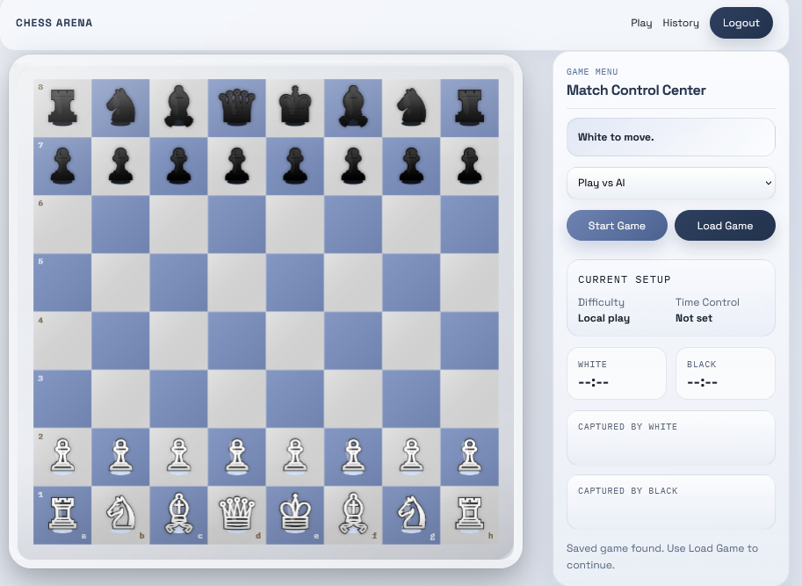



Slide 3

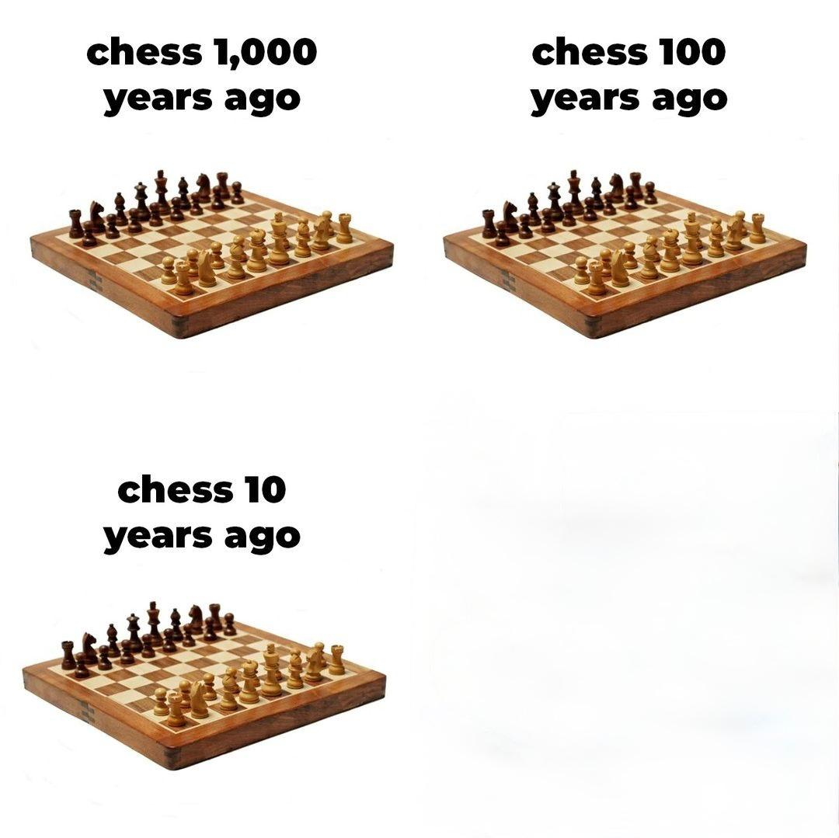

Why CHESS?

Slide 4
Github repo: https://github.com/txdoan-cpu/Topics-in-AI-Project/tree/main/Project%20Code

Slide 5


